Slide 1
SHAKESPEARE’S PROJECT
arC ANGEL CHUA, Paula merdcadal, Xènia acosta
3ER ESO C

Slide 2
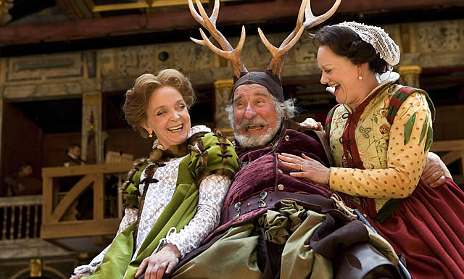
the merry wives of windsor

Slide 3
Index
The autor..............................................................................................................4, 5
Main characters.................................................................................................6, 7, 8
The development of the story......................................................................10, 11, 12

Slide 4
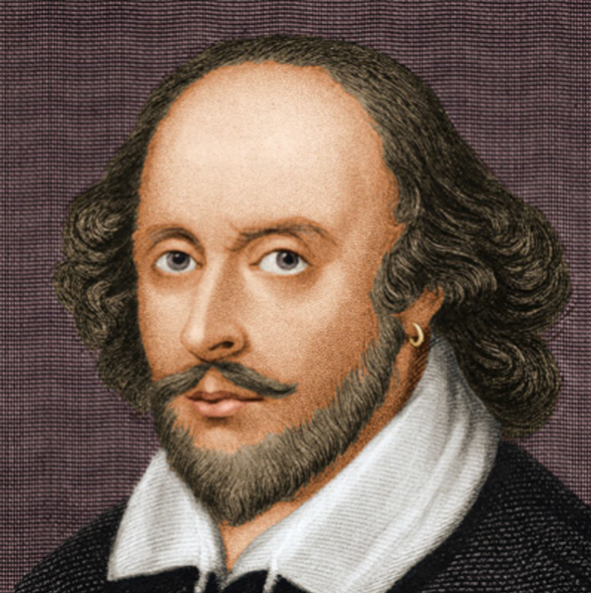
The author
William Shakespeare

Slide 5
The author→ William Shakespeare’s
William Shakespeare’s was born and brought up in Stratford upon Avon, Warwickshire.
At the age of 18, he married Anne Hathaway, with whom he had three children: Susanna and twins Hamnet and Judith.
Between 1585 and 1592, he began a successful career in London as an actor, writer, and part-owner of a playing company called the Lord Chamberlain's Men.
He appears to have retired to Stratford around 1613, at age 49.
He died on the 23rd of April 1616 at the age of 52 in Stratford upon Avon, Warwickshire, United Kingdom.

Slide 6
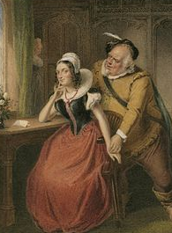
Main characters

Slide 7
Characters
Mistress Ford | A resident of Windsor, Mistress Ford is married to Ford and is a friend of Mistress Page.
Mistress Page | A resident of Windsor, Mistress Page is married to Page and is a friend of Mistress Ford
Falstaff | Falstaff is a knight, but he is also a scoundrel and occasionally a thief. Falstaff is boisterous, lively, cowardly, funny, and mischievous; he is one of Shakespeare's most beloved creations, appearing in several of his plays
Ford | Husband of Mistress Ford.
Page | Husband of Mistress Page
Sir Hugh Evans | Sir Hugh Evans is the local clergyman
Caius | The local doctor, Caius is Mistress Quickly's master.
Anne Page | Daughter of Page and Mistress Page, Anne is sought for marriage by an array of idiots, including Caius and Slender

Slide 8
Characters
Fenton | A suitor for Anne Page's hand
Slender | The third suitor for Anne Page's hand
Shallow | Shallow is a figure of the law, but nevertheless a foolish character of misplaced authority.
Mistress Quickly | Caius's servant, Mistress Quickly is everyone's messenger
Bardolph/Nim/Pistol | One of Falstaff's men
Host | Host of the Garter Inn
William Page | Page's son
Simple | Slender's servant.

Slide 9
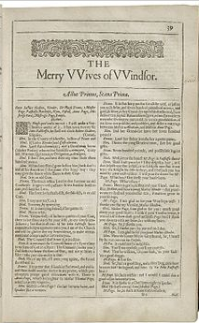
the development of the story

Slide 10
the development of the story
The play is nominally set in the early 15th century, during the same period as the Henry IV plays featuring Falstaff, but there is only one brief reference to this period, a line in which the character Fenton is said to have been one of Prince Hal's rowdy friends (he "kept company with the wild prince and Poins"). In all other respects, the play implies a contemporary setting of the Elizabethan era, c. 1600.
Falstaff arrives in Windsor very short on money. He decides, to obtain financial advantage, that he will court two wealthy married women, Mistress Ford and Mistress Page. Falstaff decides to send the women identical love letters and asks his servants – Pistol and Nym – to deliver them to the wives. When they refuse, Falstaff sacks them, and, in revenge, the men tell Ford and Page (the husbands) of Falstaff's intentions. Page is not concerned, but the jealous Ford persuades the Host of the Garter Inn to introduce him to Falstaff as a 'Master Brook' so that he can find out Falstaff's plans.

Slide 11
the development of the story
Meanwhile, three different men are trying to win the hand of Page's daughter, Anne Page. Mistress Page would like her daughter to marry Doctor Caius, a French physician, whereas the girl's father would like her to marry Master Slender. Anne herself is in love with Master Fenton, but Page had previously rejected Fenton as a suitor due to his having squandered his considerable fortune on high-class living. Hugh Evans, a Welsh parson, tries to enlist the help of Mistress Quickly (servant to Doctor Caius) in wooing Anne for Slender, but the doctor discovers this and challenges Evans to a duel. The Host of the Garter Inn prevents this duel by telling both men a different meeting place, causing much amusement for himself, Justice Shallow, Page and others. Evans and Caius decide to work together to be revenged on the Host.

